Slide 1
EARLY 20TH CENTURY
Theory of Black body radiation (Planck 1900)
Photoelectric effect (Einstein 1904)
Atomic Structure and Spectroscopy (Bohr 1913)
Compton effect (Compton 1920)

Slide 2
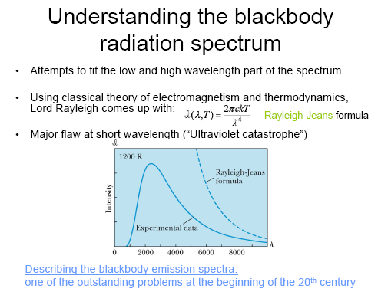

Slide 3
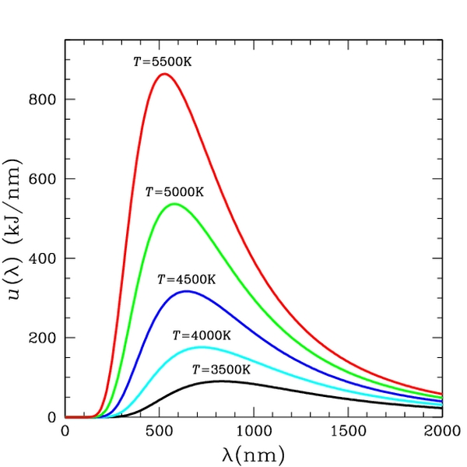
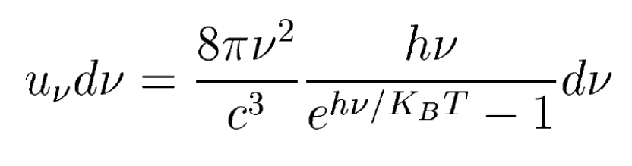
Planck's law of black body radiation (1900)
and Quanta of Energy
Planck’s assumption (1900):
Radiation of a given frequency ν could only be emitted and absorbed in “quanta” (discrete bundles) of energy
E=hν
h= Planck’s constant
=6.626x10⁻³⁴ Jsec
ν: frequency of radiation

Slide 4
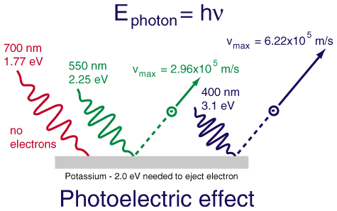
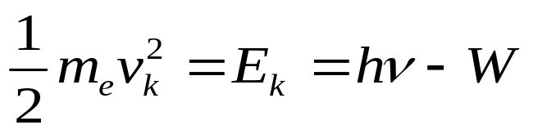
Photo Electric Effect:
In 1839, Alexandre Edmond Becquerel observed the photoelectric effect via an electrode in a conductive solution exposed to light.
In 1887, Heinrich Hertz made observations of the photoelectric effect and of the production and reception of electromagnetic (EM) waves.
In 1901, Nikola Tesla received the U.S. Patent 685957 (Apparatus for the Utilization of Radiant Energy) that describes radiation charging and discharging conductors by "radiant energy".
In 1902, Philipp von Lenard (N) observed the variation in electron energy with light frequency.
In 1905, Albert Einstein (N) proposed the well-known Einstein's equation for photoelectric effect.
In 1916, Robert Andrews Millikan (N) confirms Einstein’s explanation of photoelectric effect.
This shows that Light behaves as particles with quanta of energy
E=hν

Slide 5
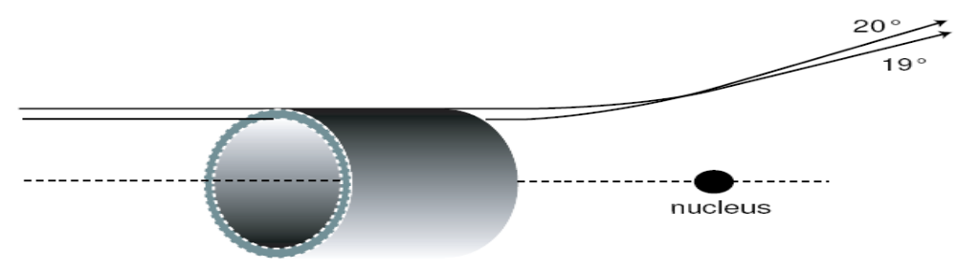
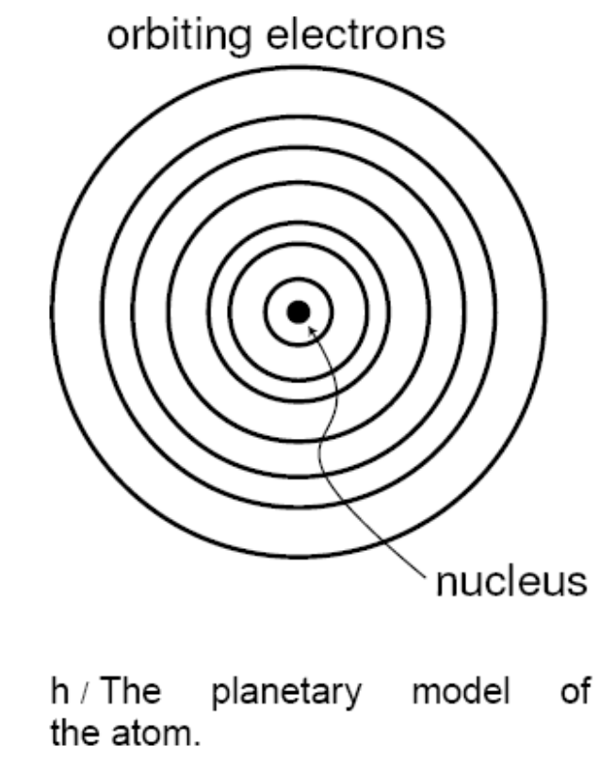
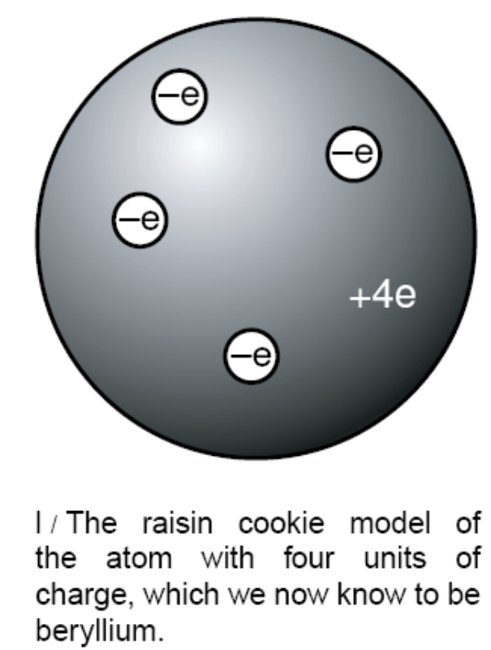
Atomic Structure
Nuclear atom model (1911):
Ernest Rutherford

Slide 6
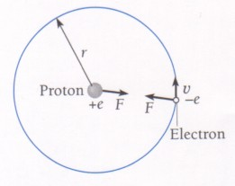
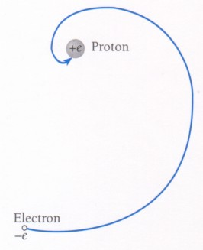
Classical physics: atoms should collapse!
This means an electron should fall into the nucleus.
Classical Electrodynamics: charged particles radiate EM energy (photons) when their velocity vector changes (e.g. they accelerate).
New mechanics is needed!

Slide 7




Spectroscopy
from n ≥ 3 to n = 2
Balmer series (1885)
visible spectrum
Rydberg formula for hydrogen (1888)
Rydberg formula for all hydrogen-like atom (1888)
Bohr's formula (1913)

Slide 8
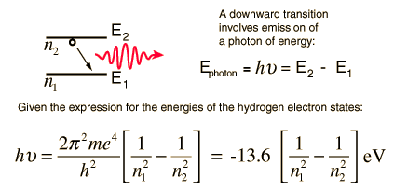




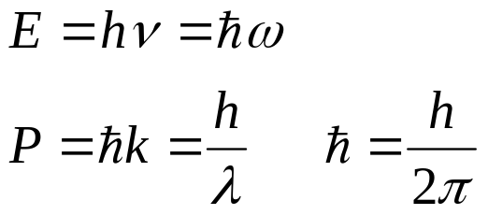

Old Quantum Theory
Niels Henrik David Bohr, model of atomic structure, 1913
The electron's orbital angular momentum is quantized
Electrons travel in discrete orbits around the atom's nucleus.
The chemical properties of the element being largely determined by the number of electrons in each of the outer orbits
Energy and Momentum of Photons

Slide 9
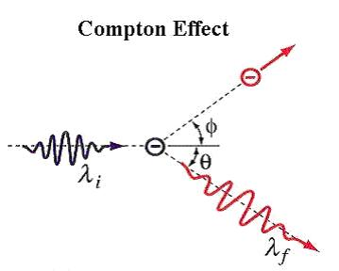
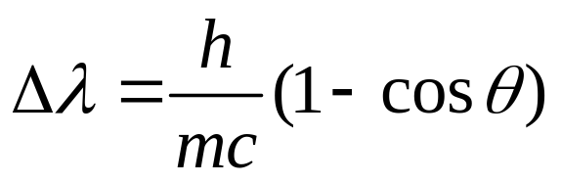
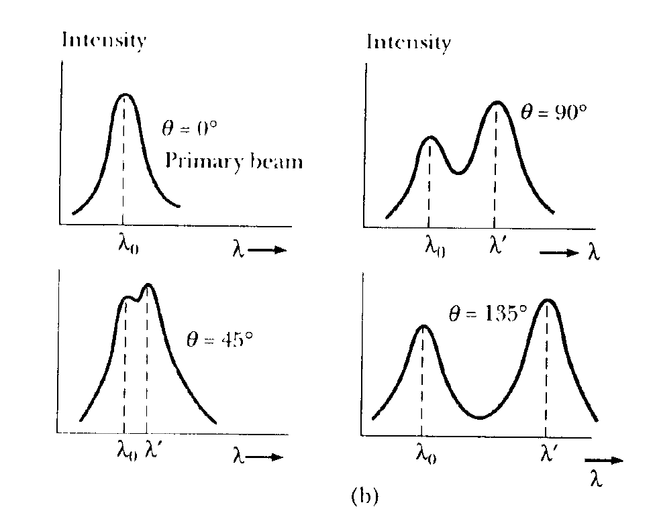
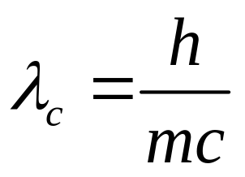

Shift in wavelength of the scattered photon in Compton Scattering
Compton wavelength

Slide 10
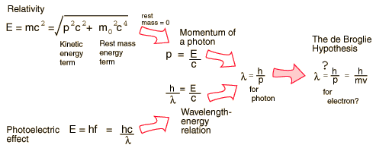
de Broglie matter wave hypothesis (1923):
All matter has a wave-like nature (wave-particle duality) and that the wavelength and momentum of a particle are related by a simple equation.

Slide 11
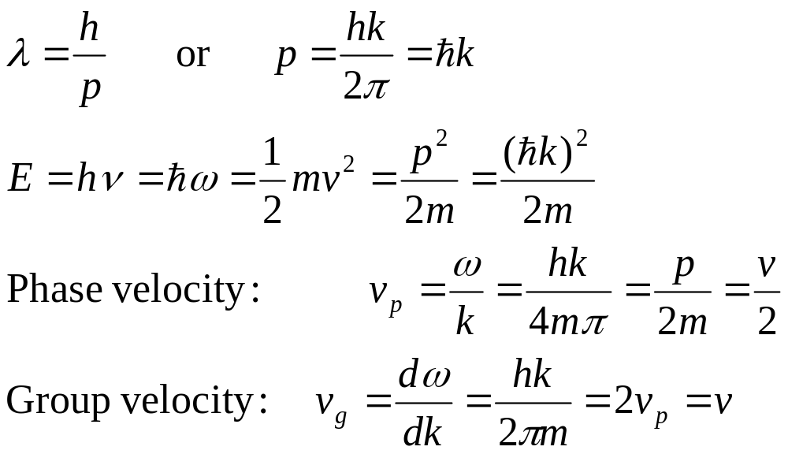
Phase velocity, Group velocity and velocity of the particles
Group velocity v_{g} is same as the particle velocity v

Slide 12
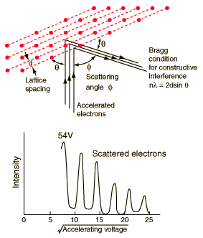
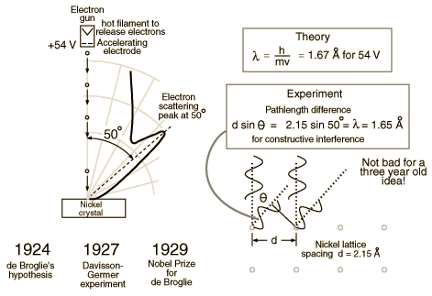
Davisson-Germer Experiment (1927)
Electron has wave nature (diffraction)!

Slide 13
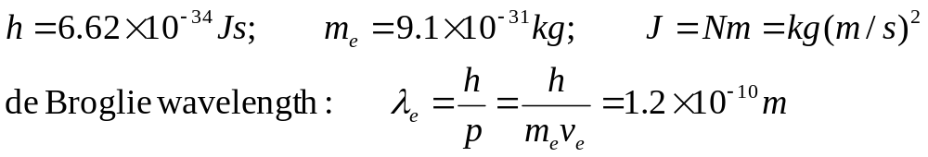
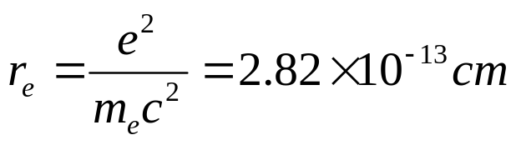
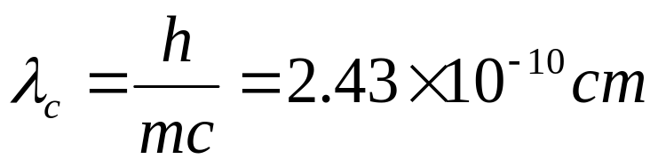
De Broglie wavelength of electron for v_{e}=6x10⁶ m/s:
Distance at which wave nature is prominent
Classical radius: e⁻ can be viewed as a particle with radius r_{e}:
Compton Wavelength:
Distance at which quantum effects cannot be ignored

Slide 14
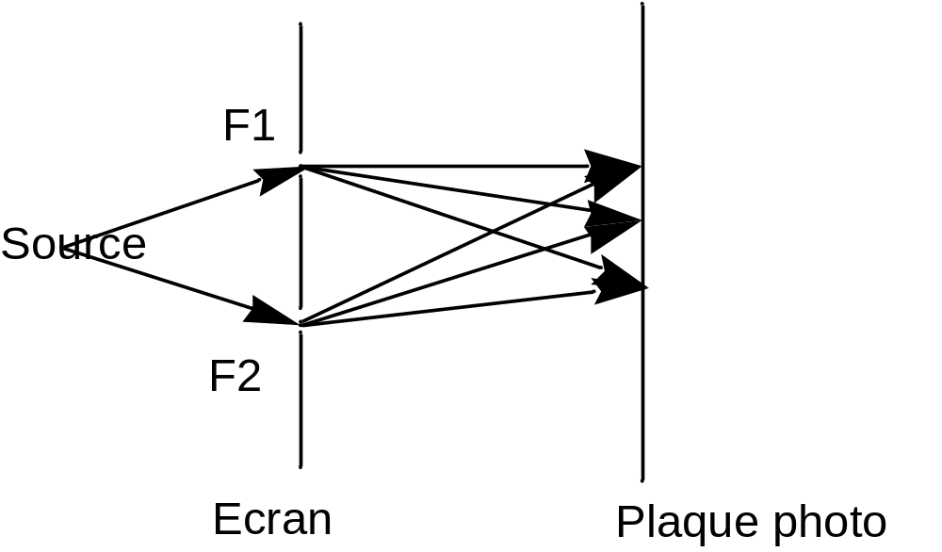


Young's Double Slit Experiment
This is a typical experiment showing the wave nature of light and interferences.
What happens when we decrease the light intensity ?
If radiation = particles, individual photons reach one spot and there will be no interferences
If radiation ≠ particles there will be no spots on the screen
The result is ambiguous
There are spots
The superposition of all the
impacts make interferences
Assuming a single electron each time
What means interference with itself ?
What is its trajectory?
If it goes through F1, it should ignore the presence of F2

Slide 15
Young's Double Slit Experiment
There is no possibility of knowing through which split the photon went!
If we measure the crossing through F1, we have to place a screen behind.
Then it does not go to the final screen.
We know that it goes through F1 but we do not know where it would go after.
These two questions are not compatible
Two important differences with classical physics:
measurement is not independent from observer
trajectories are not defined; hν goes through F1 and F2 both! or through them with equal probabilities!
Mask with 2 slits
Screen

Slide 16
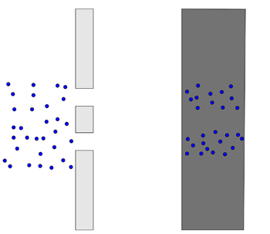

Slide 17
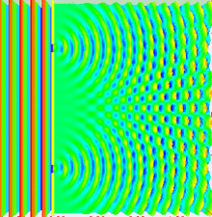
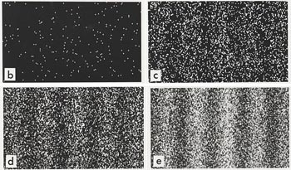
Optics: with light
QM: with electrons

Slide 18
Birth of Quantum Mechanics
The necessity for quantum mechanics was a series of observations.
The theory of QM developed with a set of postulates.
QM cannot be deduced from pure mathematical or logical reasoning.
QM is not intuitive, because we cannot visualize atomic size.
QM is based on observation. Like all science, it is subject to change if inconsistencies with further observation are revealed.
New concepts in Quantum Mechanics:
Wave-Particle Duality
Superposition of states
Uncertainty Principle

Slide 19
Wave-Particle Duality

Slide 20
Wave interpretation of particles:
Schrodinger formalism
Wave functions
Significance of wave function
Normalisation
The time-independent Schrödinger Equation.
Solutions of the Schrödinger equation

Slide 21
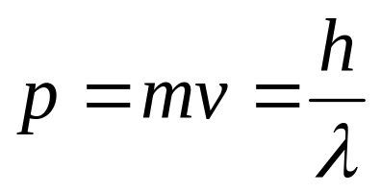
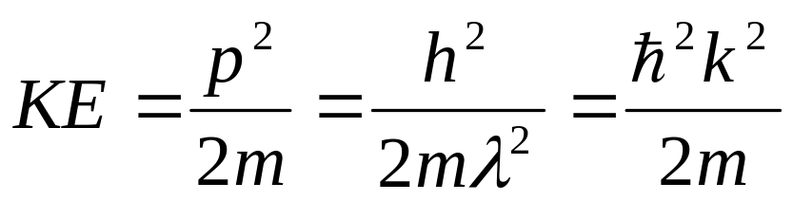
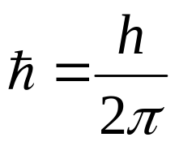
The de Broglie Hypothesis
In 1924, de Broglie suggested that if waves of wavelength λ were associated with particles of momentum p=h/λ, then it should also work the other way round.
A particle of mass m, moving with velocity v has momentum p:
Kinetic Energy of particle
If the de Broglie hypothesis is correct, then a stream of classical particles should show evidence of wave-like characteristics.

Slide 22
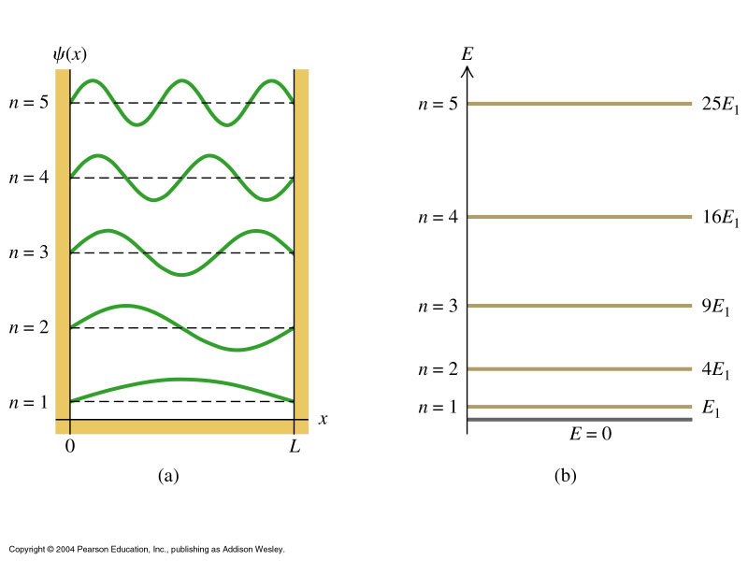
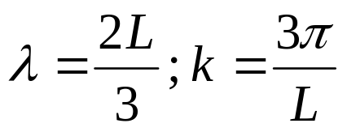
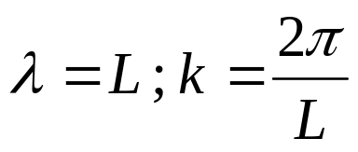
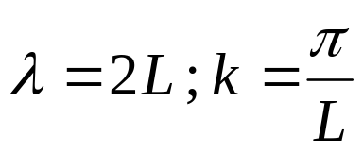
Wavelengths of confined states
V=∞
V=∞
In general, k =nπ/L, n= number of antinodes in standing wave
V=0
infinite potential well

Slide 23
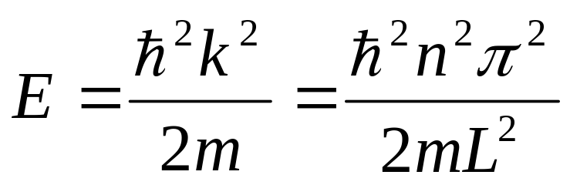
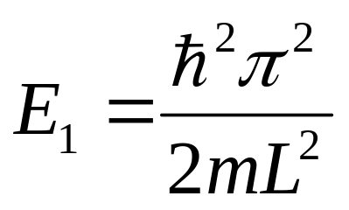
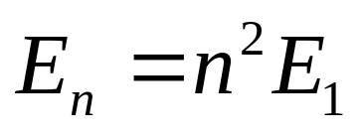
Energies of confined states

Slide 24
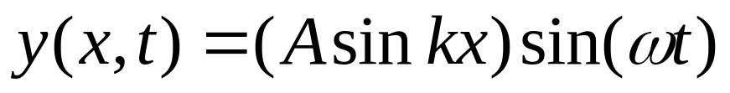
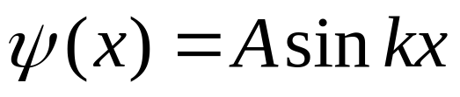
Particle in a box: wave functions
Standing wave on a string has the form:
Initial condition: y(0,t) = 0:
Our particle in a box wave functions represent STATIONARY (time independent) states, so we write:
A is a constant, to be determined

Slide 25
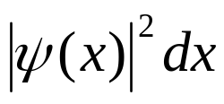
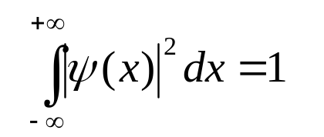
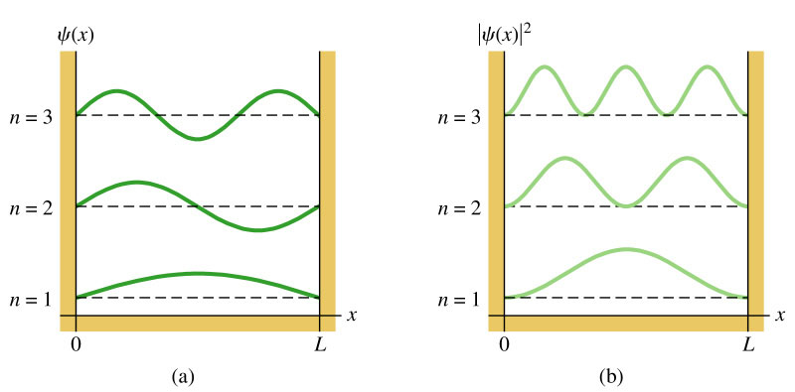
Interpretation of the wave function
The wave function of a particle is related to the probability density.
Probability of finding a particle between x and x + dx:
The wave function is normalized by stating that the total probability of
finding the particle somewhere = 1:

Slide 26
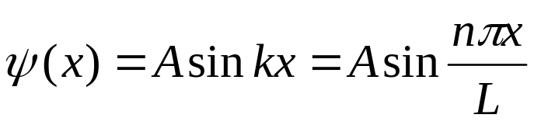
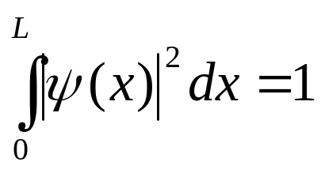
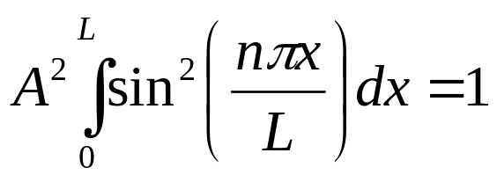
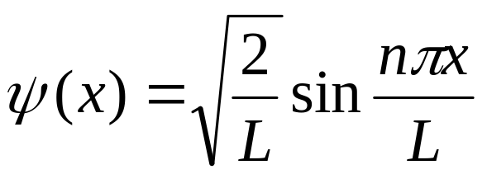
Particle in a box: normalization of wave functions
Normalization condition determines one constant in the wave function. For our particle in a box we have:
Since, in this case the particle is confined by INFINITE potential barriers, we know particle must be located between x=0 and x=L →Normalisation condition reduces to :

Slide 27
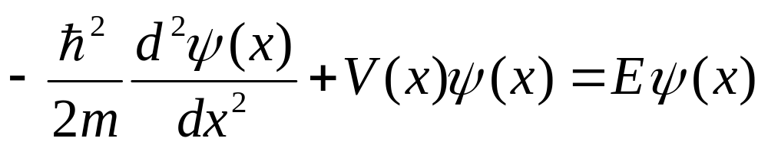
SCHRÖDINGER EQUATION
So far we have only treated a very simple one-dimensional case of a particle in a completely confining potential.
A general treatment of any problem requires the development of a more sophisticated “QUANTUM MECHANICS” based on the
SCHRÖDINGER EQUATION
KE Term
PE Term
In 1-dimension (time-independent)

Slide 28
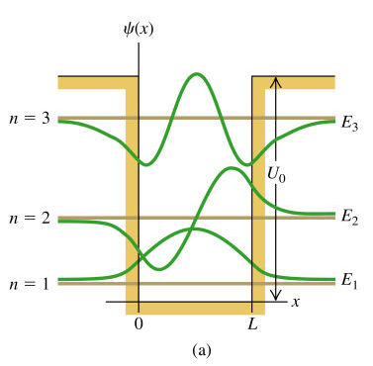
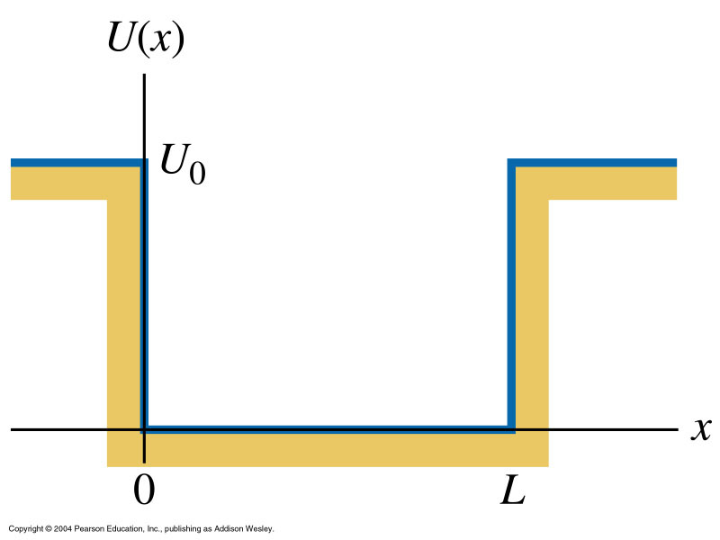
Solving the Schrodinger equation allows us to calculate particle wave functions for a wide range of situations
Finite potential well
WF “leakage”, particle has finite probability of being found in barrier: CLASSICALLY FORBIDDEN

Slide 29
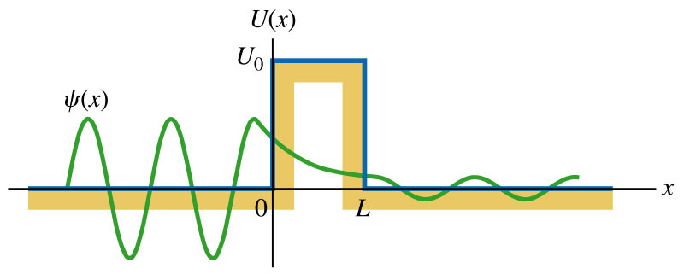
Solving the Schrodinger equation allows us to calculate particle wave functions for a wide range of situations
Barrier Penetration (Tunnelling)
Quantum mechanics allows particles to travel through “brick walls”!!!!

Slide 30




Solving the Schrodinger equation for particle in an infinite potential well
So, for 0<x<L, the time independent SE reduces to:
General Solution:

Slide 31




Boundary condition: ψ(x) = 0 when x=0:→B=0
Boundary condition: ψ(x) = 0 when x=L:
In agreement with the “fitting waves in boxes” treatment earlier.

Slide 32
Fundamental postulates of QM
How is the physical state described?
How are physical observables represented?
What are the results of measurement?
How does the physical state evolve in time?
These postulates are fundamental, and cannot be explained by any theory.
The theory is rather concerned with the consequences of these postulates.

Slide 33

Superposition of States:
If two states |a> and |b> are equally probable to any system |S>,
Quantum Mechanics would treat both the states on equal footing:
Any observation would find the system in the state |a> or |b>
Probability of getting result a or b depends on
relative weights of A and B in the superposition.
Act of observation of a small Q. M. system causes a non-negligible disturbance.
Therefore, the results of one observation will not allow
a causal prediction of the results of a subsequent observation.
Indeterminacy comes in calculation of observables.
Act of observation destroys causality.
Theory gives probability of obtaining a particular result.

Slide 34
Linear Algebra of Quantum Mechanics

Slide 35


The mathematical structure QM describes is a linear algebra of
operators acting on a vector space.
Under Dirac notation, we denote a vector using a “ket”:

Slide 36



A vector space is n-demensional if
the maximum number of linearly independent vectors in the space is n.
A set of n linearly independent vectors in n-dimensional space is a basis
--- any vector can be written in a unique way as a sum over a basis:
Once the basis is chosen, a vector can be represented by a column vector:

Slide 37



Usually we require the basis to be orthonormal:
A linearly independent set of basis vectors can be made orthonormal
using the Gram-Schmidt procedure.

Slide 38



Slide 39



Slide 40



Slide 41

Unitary operator possesses the following properties:

Slide 42



Eigenkets and Eigenvalues:
Eigenvalues are roots to the characteristic polynomial
The set of eigenvalues of an operator satisfy:

Slide 43

Eigenkets and Eigenvalues of Hermitian Operators:
All the eigenvalues are real.
Eigenkets belonging to different eigenvalues are orthogonal.
The complete eigenkets can form an orthonormal basis.
The operator can be written as
Hermitian linear operator Real dynamical variable
– represents observable quantity
Eigenvector A state associated with an observable
Eigenvalue Value of observable associated with a particular linear operator and eigenvector

Slide 44

If |a_{i}> are eigenvectors of A and |b_{i}> are eigenvectors of B
Measurement of an observable, which is represented by the operator A
will find the system in one of the states |a_{i}> with value a_{i}
Measurement of observable B will find the system in a combination of states |b_{i}>

Slide 45




Commuting operators:
[A,B] = AB-BA=0
A and B operators can have simultaneous eigenvalues.
Simultaneous measurements of A and B
will find the system in one of the states
Commutator and classical Poisson bracket {x,p_{x}}:

Slide 46











Classical Mechanics
Newton
Lagrangian
Hamiltonian

Slide 47





Classical Mechanics
Poisson Bracket
Equation of motion of any dynamical variable:

Slide 48





Simultaneous precise measurement of A and B is not possible

Slide 49




Using Schwarz inequality:
When A and B are cannonical variables, like, (x,p_{x}) or (t,E)
satisfying commutation relations like
satisfies the uncertainty principle

Slide 50

Uncertainty Principle
"There is a limit to the fineness of our powers of observation and the smallness of the accompanying disturbance, a limit which is inherent in the nature of things and can never be surpassed by improved technique or increased skill on the part of the observer."
Dirac

Slide 51



Position space wave function:

Slide 52



Momentum space wave function:

Slide 53



Schrödinger Equation

